Slide 1
1L Course Selection
Madison Faraut| Registration & Exams Administrator
Caroline McCallum| Assistant Registrar of Enrollment Services
Megan Markov | Deputy Registrar

Slide 2
Important Dates:
1L January Experiential Term (JET) Round:
  Opens: Monday, November 2nd @ 9am
  Closes: Wednesday, November 4th @ 5pm
  Results posted Friday, November 6th by 5pm
  Deadline to change JET class: Wednesday, December 2nd 11:59pm
1L Spring Upper-level Elective Round:
  Opens: Monday, November 9th @ 9am
  Closes: Thursday, November 12th @ 5pm
  Results posted Tuesday, November 17th by 5pm
  Deadline to change Spring elective: Friday, January 29th 11:59pm
https://hls.harvard.edu/academics/curriculum/registration-information/

Slide 3
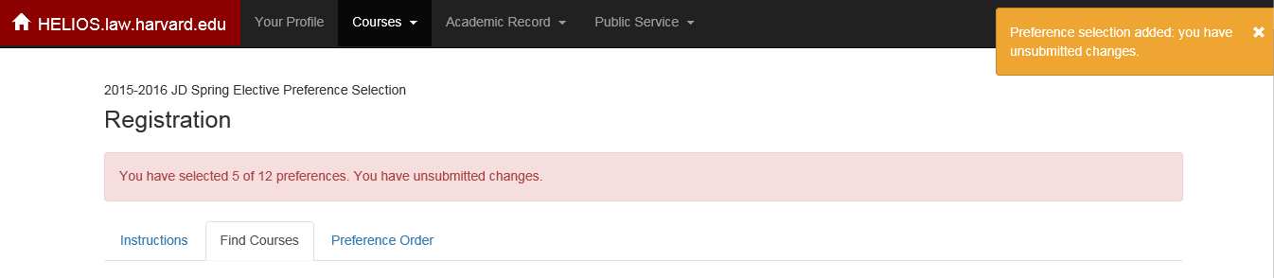
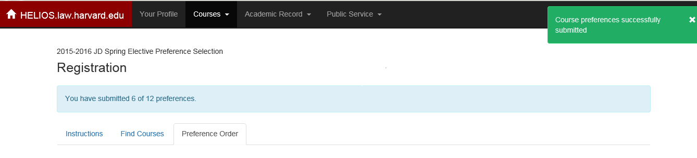
Course Selection in Helios
Similar to the 1L Reading Group round, you will select classes and submit preferences on Helios
Courses > Registration > Find Courses
You can adjust your list of classes under the “Preference Order” tab
If you update your preferences, you MUST return to the “Preference Order” tab and select “Submit Preferences” each time.

Slide 4
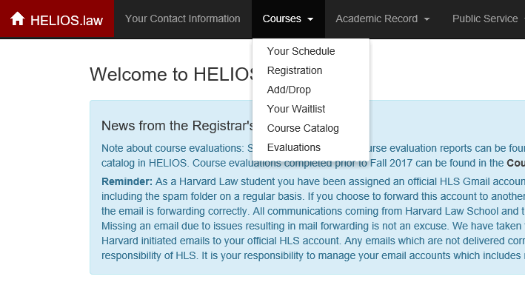
Course Selection in Helios

Slide 5
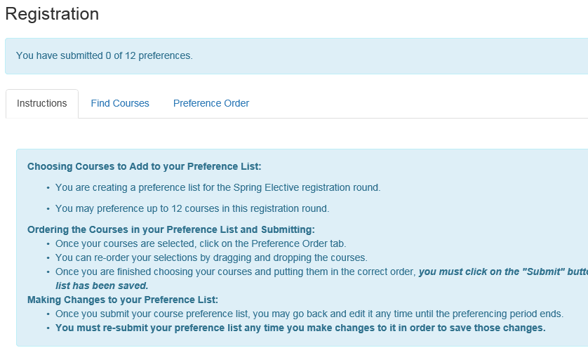
Step 1: Select the Registration Tab & Review Instructions
Sample screenshot of what you should see in the Registration Page

Slide 6
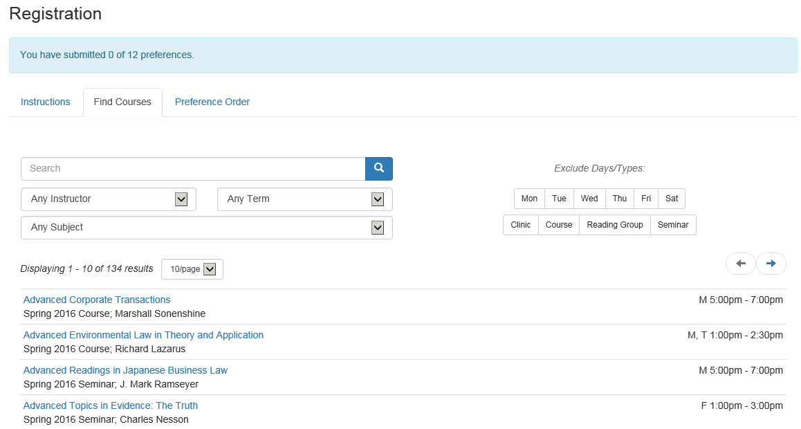
Step 2: Select the Find Courses Tab

Slide 7
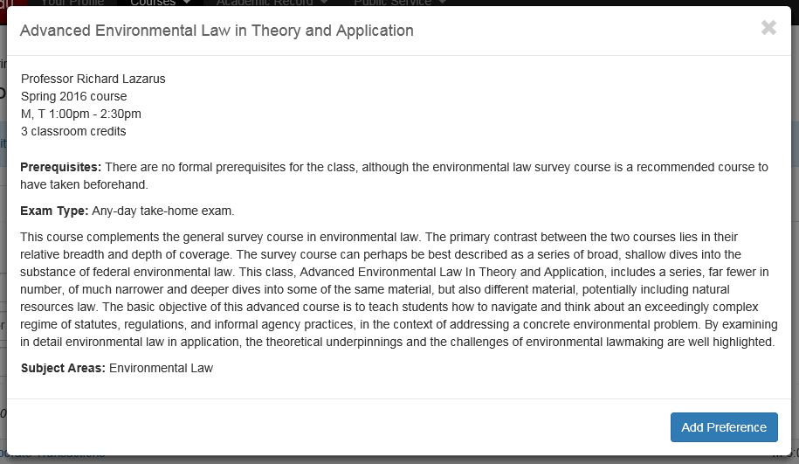
Step 3: Search Courses and Add Preferences

Slide 8
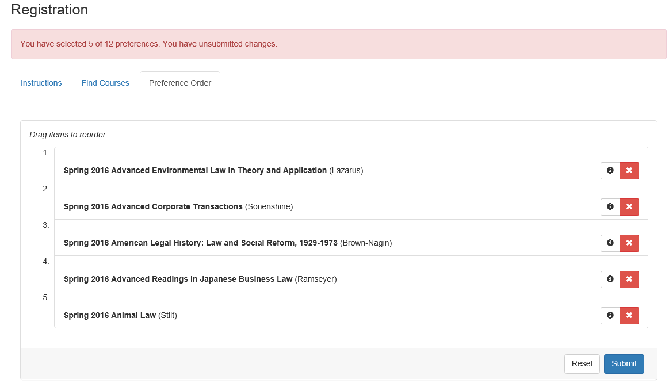
Step 4a: Select Preference Order Tab and Submit Preferences
You can drag and drop the courses to easily re-order your preferences; don’t forget to press “submit” to save your changes!

Slide 9

Step 4b: Receive Popup Confirmation of Successfully Submitted Preferences

Slide 10
Steps 1-4: Unsubmitted Changes & Re-submitting Preferences
If you update your preferences during any phase, you MUST return to the “Preference Order” tab and select “Submit Preferences” each time. Otherwise, your changes will NOT be saved.

Slide 11
Degree Requirements
All JET courses satisfy the negotiation/leadership requirement:
  Advocacy: The Courtroom and Beyond
  Leadership Fundamentals
  Negotiation Workshop
  Technology and the Public Interest
  The Craft of Lawyering
  Lawyering for Justice in the United States
Legal Profession: Public Interest Lawyering fulfills the Professional Responsibility requirement.
There are several spring electives that fulfill the International/Comparative requirement.
The upper-level writing requirement cannot be completed or worked on as a 1L student.
  If you have questions about the writing requirement, please email registrar@law.harvard.edu
Review your personalized degree audit in Helios!

Slide 12
Course Selection Resources
2026-2027 1L Registration Information | 1L Section Spring Elective Lists
1L Registration Preferencing FAQs
Course Catalog | Class details, by perm classes, requirements; filtered searches
Course and Schedule Updates
Tentative Spring 2027 Exam Schedule
Office of Student Academic Affairs
  Drop-in hours every Friday 12-5pm
  First Steps x Academic Path small group advising sessions
BSA Advisors
Programs of Study
Course Evaluations available in Helios
Ask the Registrar tables at the Hark Ramp
  Tuesday, November 3rd – 11am-1pm
  Tuesday, November 10th – 11am-1pm

Slide 13
1L Spring Upper-level Elective Round
All 1Ls must enroll in one, 2-4 credit elective during their spring semester.
Students must preference between 6 and 12 courses during this registration round.
When preferencing, all courses available to 1Ls will be shown. However, you should only preference courses included in your section list.
  If you preference a course not included on your section list, you will not be enrolled and you will be wasting a bid.

Slide 14

Now that your preferences are submitted, what’s next?
Confirmation of Bids Email:
  Sent to all students that submitted bids (approximately 1 hour after closing of bids).
  If you do not receive this email then we did not receive your bids.
    In this case, email the Registrar’s Office with a list of your preferences via registrar@law.Harvard.edu
The enrollment algorithm runs.
Results are released in Helios by 5pm on the stated release date for that round.

Slide 15
Viewing your Results and Waitlist Positions

Slide 16
Add/Drop & Waitlist Processing:
Add/drop begins once results are released for each round.
  Add/drop deadlines:
    January Experiential Term: Wednesday December 2nd at 11:59pm ET.
    Spring Upper-level Elective: Friday, January 29th at 11:59pm ET.
Waitlist processing:
  Waitlists are processed in priority order.
  Students have 15-hours to accept waitlist offers.
  Waitlist processing will pause in early December for the fall exam period and will resume after winter break.
For more information on add/drop and waitlist processing, please see our Course and Clinic Selection Information page.

Slide 17

Course Selection Reminders:
For successful course selection:
Note all dates and deadlines
Utilize all available resources
Complete and submit preferences in Helios
Must always select “Submit” to save changes

Slide 18
Do you have additional Questions?
Read the Frequently Asked Questions for 1L Registration
Contact us at Office of the Registrar
registrar@law.harvard.edu
WCC, Suite 4007
617.495.4612
Madison Faraut, Registration & Exams Administrator
mfaraut@law.harvard.edu
Caroline McCallum, Assistant Registrar of Enrollment Services
cmccallum@law.harvard.edu

