Slide 1
HLS Exams Quick Info
Melanie Dwyer Registration and Exams Administrator
Caroline McCallum Assistant Registrar of Enrollment Services

Slide 2
What we’ll cover today:
Planning ahead: How to get started
Exam IDs & anonymous grading
Exam Types: How to get your exam questions
Exam4 Tips
Exam modes, don’t copy+paste, efficiency tips
Illness, distress, and emergencies during an exam
Technological issues during the exam period

Slide 3
Planning Ahead
Download the latest version of the Exam4 software from Exam4.com.
Your exam will not be scheduled the same time or place as your usual class meetings. Check the Exam Schedule
The Exam Schedule is always being updated as soon as the RO receives information. If the information is not posted, that means we do not yet have it.
Instructors are required to post to Canvas the information on the exam cover sheet that indicates the mode, materials allowed, and other instructions 48hrs prior to the exam.
Not yet posted in 48hrs? Contact the RO so we can get this info for the class.
For Cross-Registrants and Cross-Listed students, look for an email from the HLS Registrar’s Office that will contain your exam ID.
HLS exams are ANONYMOUSLY GRADED.
Faculty contact concerning exams is prohibited prior to the release of grades. You must not consult with the faculty member about any exam administration or scheduling issues.

Slide 4
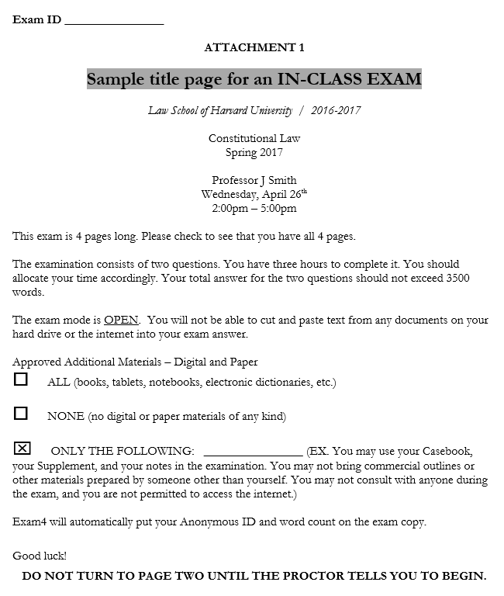
Sample Cover Page

Slide 5
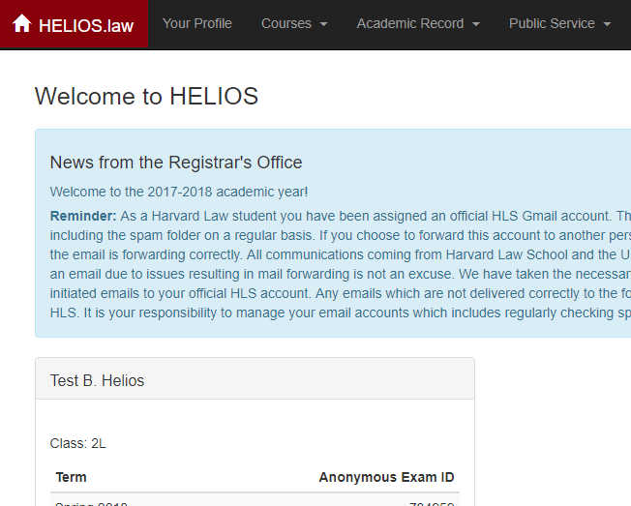
HLS Finding Your Exam ID
Make sure it is for the correct term.

Slide 6
Anonymous Grading & Exam IDs:
All HLS exams are graded anonymously.
Do not include your name or any identifying factors about yourself in your exam.
Should you do so, this may result in Ad Board actions.
You should only identify yourself by your Spring 2024 Exam ID.
All exam ids are 6-digits and change each term.
Your exam ids are listed on your home page in Helios.
For XREG students, we will send your exam IDs to you.
For XLIST students, use the last 6-digits of your HUID.
Contact with your faculty member regarding your exam is prohibited prior to the release of grades. You must not consult with the faculty member about any exam administration or scheduling issues.
Your HUID is not your Exam ID! DO NOT use your HUID.

Slide 7
Exam Types and Deadlines
In Class Exams: Plan to arrive 10-15 minutes prior to the scheduled start time. The classroom exam proctors are the official time keepers of in-class exams.
Takehome Exams: Download questions at Exam4.com; downloading starts the clock.
One-day Takehome (ODTH): Available for download between 8:15 and 8:30am ET.
Your completed exam must be uploaded the specified number of hours from the time you download the questions, or by the final deadline time (e.g. 4:30pm ET on the exam day for 8 hour exams), whichever time is earlier. This final deadline will be noted on the exam schedule webpage.
Any-day Takehome:
Available for download anytime during the exam period.
Must submit your answer within the allotted timeframe
All answers are due no later than 4:30pm ET on May 3rd *
Last-class Takehome:
All answers must be submitted by 4:30pm ET on May 3rd * *some may have atypical date ranges, check the exam schedule to be sure

Slide 8
Getting Your Exam Questions
In-Class Exams: exam questions will be handed out by Proctors. At the conclusion of the exam, you must return the exam copy to the Proctors. All In-Class Exams are secure.
Takehome Exams: download the exam questions from the Exam4.com website. Submit your answers through the Exam4 software.
website
proctors

Slide 9
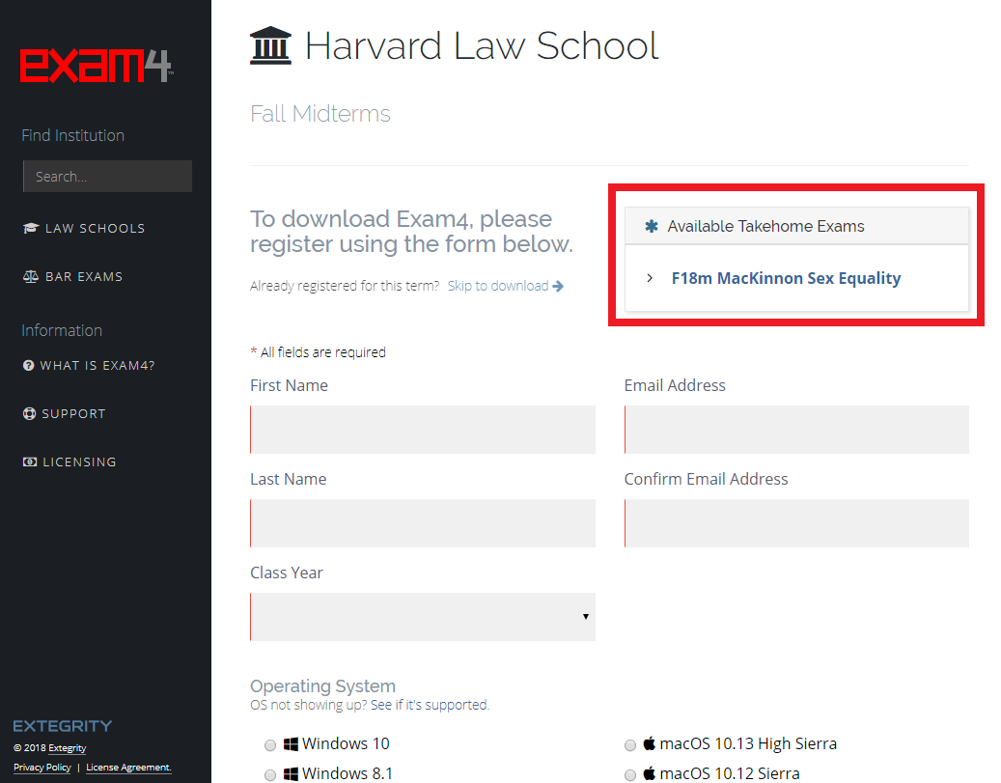
Downloading Your Takehome Exam from Exam4.com
Visit Exam4.com.
Search for Harvard Law School: www.exam4.com/org/684
Find your takehome exam on the right hand panel (see screenshot on right).
Enter your Exam ID for the correct term.
Start the exam by downloading the exam questions.

Slide 10
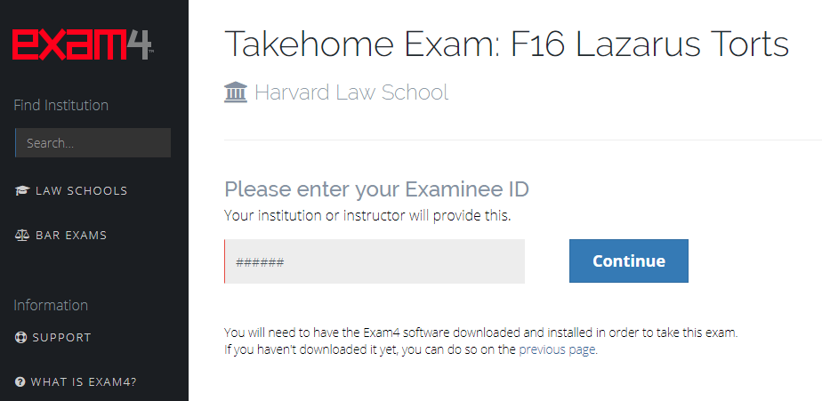
Downloading Your Takehome Exam from Exam4.com
Step 4

Slide 11
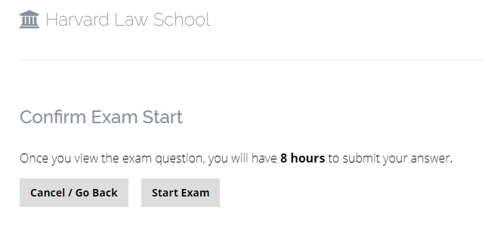
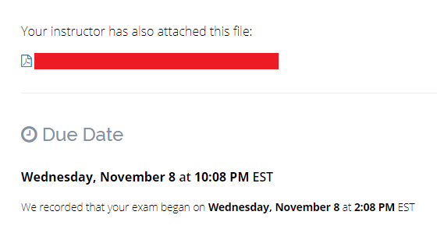
Downloading Your Takehome Exam from Exam4.com
Step 5
Clicking on “Start Exam” starts the clock!
An any-day Takehome exam example

Slide 12
Exam Modes in Exam4
CLOSED (In-Class exams):
No access to hard drive or internet.
Security check required.
OPEN (In-Class exams):
Access to hard drive but not the internet.
Cannot cut & paste from external documents.
OPEN + NETWORK (In-Class exams):
Access to hard drive and internet.
Cannot cut & paste from external documents.
TAKEHOME (all Takehome exams):
Access to hard drive and internet.
Reminder: Regardless of mode, faculty instructions may have stricter rules on the exam, limiting what students may or may not access.

Slide 13
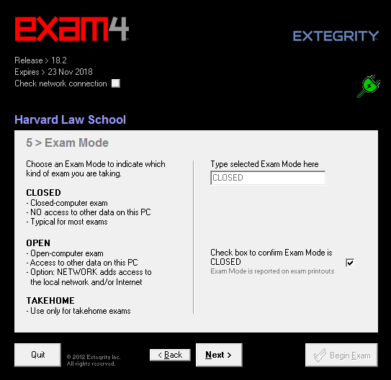
In-Class Exam Mode: Closed
Type“CLOSED” in the first field.

Slide 14
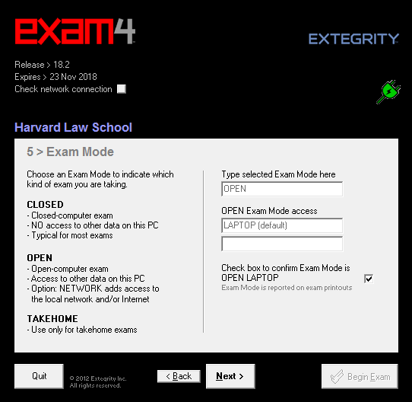
In-Class Exam Mode: Open
Type “OPEN” in the first field.

Slide 15
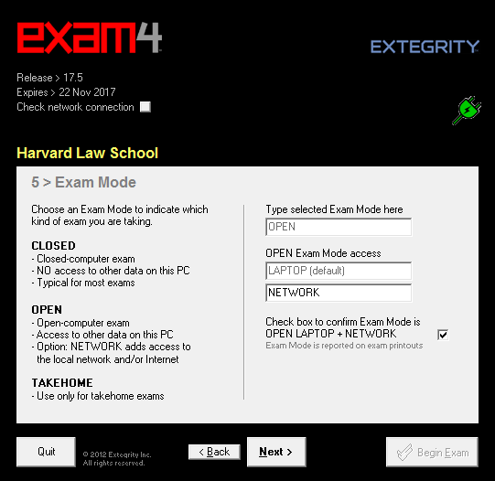
In-Class Exam Mode: Open + Network
Type in “OPEN” and type in “NETWORK” in the field below.

Slide 16
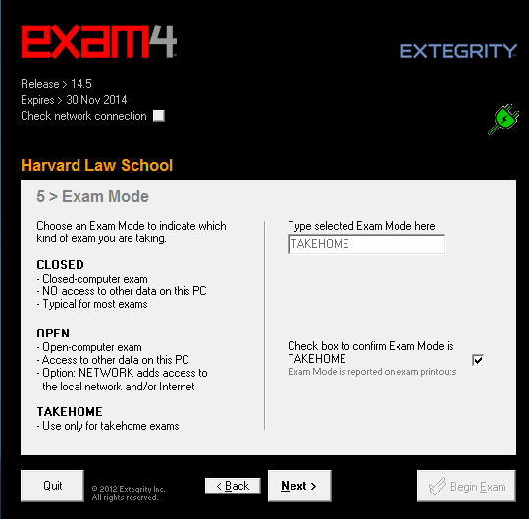
Takehome Exam Mode
Type in “TAKEHOME” in the first field.

Slide 17
Cutting and Pasting Answers
We strongly encourage all students to write their Takehomes in Exam4 ONLY.
Students have experienced many issues while trying to cut and paste exam responses into Exam4:
A loss of formatting or issues with formatting not available in Exam4.
A loss of work when the other program crashed.
A loss of work by cutting/pasting incorrectly at the last minute.
Submitting an exam late, in response to trying to resolve these issues.

Slide 18
Write your Takehome in Exam4
Exam4 auto saves a copy of your exam file every two minutes to your hard drive.
This helps to ensure that you don’t lose work and that you have a digital history of your progress.
Under NO circumstances, should in-class exams be completed in Word.

Slide 19
Exam4 Efficiency Tips
Make sure you have the exam ID for the correct term. Ask the Proctors in an in-class exam for your ID if you forgot it.
Download and install the software as soon as it is available. Restart your computer after installing the Exam4 software.
It may prompt you to make patch updates to your operating system. This is to ensure the software is running with a compatible OS version.
Take a technical practice test in different exam modes to make sure you are able to submit successfully to the server with those modes (Open, Closed, Takehome mode)

Slide 20
Exam4 Efficiency Tips
Is your computer running slow? Too many browser tabs or programs open slows down processing. Shut down all programs except Exam4 and the documents you need. Make sure laptops are plugged in.
Is the word counter delayed? The word count window does not count as you type, but run in a few second intervals. To avoid distraction, keep the word count window closed and refer to it only when needed.
If you have a Takehome exam, you can open up and set up in the software first to save time, then download the exam questions from the Exam4.com website. Downloading the questions starts the timer!
Write your exam in Exam4 from start to finish. Copying and pasting from Word, Google Docs, etc. is NOT recommended!

Slide 21
Emergency During the Exam Period
If a family, medical, or personal emergency occurs during the exam period, accommodations may be possible.
For immediate assistance, call 617-495-0722, and press 1 for Exam Support. This service will be available from 7:30am – 6:30pm Eastern Standard Time (EST), Monday – Friday, during the exam season.
Outside of these hours, please email Dean of Students office: dos@law.harvard.edu

Slide 22
Technical Issues before exam
Prior to your exams, complete a technical Exam4 practice exam in order to eliminate any technical surprises during the exam period.
If you’re having trouble with your laptop or it does not pass the security check:
Borrow a laptop from the ITS service desk, which operates on a first-come, first-serve basis during the exam period. They can be picked up starting at 7:30am on each exam day, but must be returned by the following day.
Sit for the exam in the WCC lab, which opens at 7:30am ET M-F on exam days.

Slide 23
Technical Issues during exam
Tech issue during in-class exam:
ALERT a proctor immediately.
From there the proctor will assess and you may be directed to the WCC computer lab to finish your exam.
Tech issue during takehome exam:
Call 617-495-0722, and press 1 for Exam Support.
This service will be available from 7:30am – 6:30pm Eastern Daylight Time (EST), Monday – Friday, during the exam period.

Slide 24
If Sick Before an Exam…
DO NOT begin your exam. Contact the Dean of Students Office to notify them of the situation.
Make an appointment with HUHS and obtain medical documentation from that visit to submit to the Dean of Students Office.
Always follow up with DOS after your visit.

Slide 25
If Sick During an In-Class Exam…
You should stop your exam, tell the proctor about the illness and request go to HUHS.
You should then make an appointment with HUHS and obtain documentation from that visit to submit to the Dean of Students Office.
Always follow up with DOS after your visit.
If you do not stop your exam, you cannot receive retroactive accommodations.

Slide 26
In Closing…
To have a successful exam period, keep in mind:
Contact our offices if you are experiencing any illness, distress, or technological issues before/during an exam.
All HLS exams are graded anonymously.
Be mindful of your exam type, deadline, and mode.
Make sure that you receive the “Exam Submittal Successful” pop-up at the end of each exam!

Slide 27
Questions?
Office of the Registrar | registrar@law.harvard.edu 617-495-4612 | WCC, Suite 4007
Melanie Dwyer |mdwyer@law.harvard.edu
Registration and Exams Administrator
Caroline McCallum| cmccallum@law.harvard.edu
Assistant Registrar of Enrollment Services

