Slide 1
Tips and tricks for good storytelling
HLS Communications

Slide 2
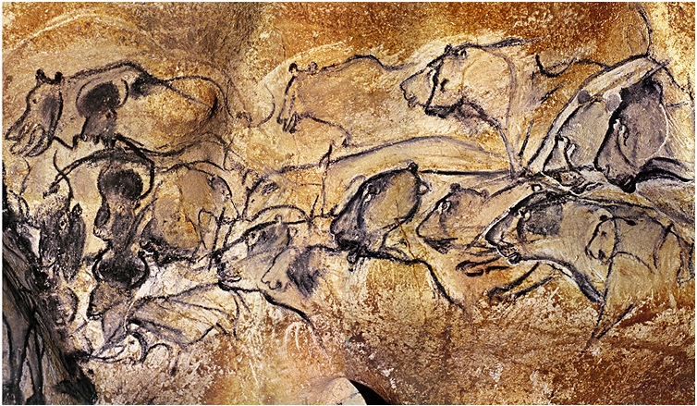
Humans are a storytelling animal
We all do it!
Humans tell stories to connect, explain our world, find meaning, and be entertained
Sometimes, good storytelling requires us to shift out of “work writing” mode – think about how you tell stories to your friends and loved ones

Slide 3
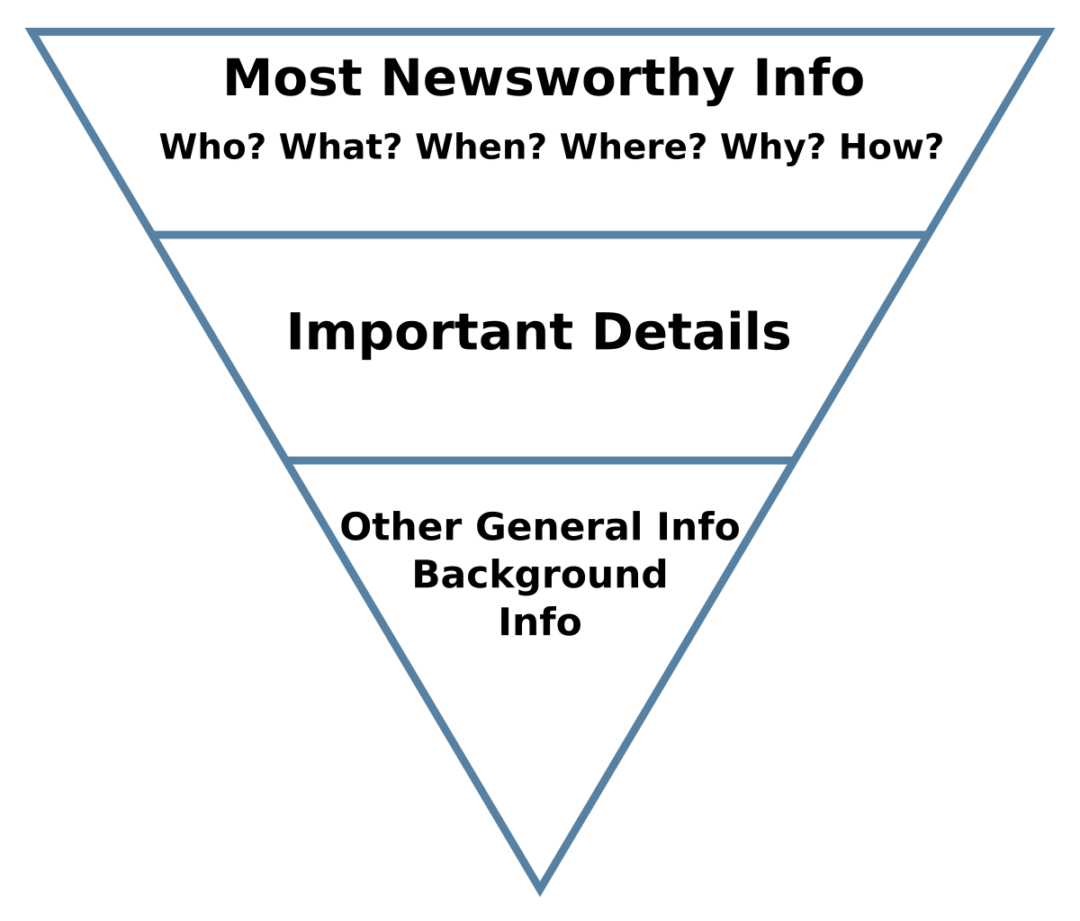
Hard (or straight) news
These stories convey a breaking piece (or pieces) of news. Event coverage generally also fits here.
Write a compelling headline and subhead (see Jeff’s excellent presentation for more)
Follow the inverted pyramid structure – lead with the important information at the beginning, then go into details and quotes (if necessary)
Remember that many people will not read beyond your first sentence or paragraph, so all important info should be there!
Try to answer the 5Ws and 1H (who, what, when, where, why, how) within the first few sentences
If you get stuck on how tell an event story, one approach is to figure out the most interesting or provocative thing anyone said, and lead with that

Slide 4
Feature stories
A feature goes beyond the typical hard news story, weaving in human interest and colorful details to help a reader better understand an issue in depth
We’re not just trying to get information out there – we’re trying to build deeper interest and engagement

Slide 5
Pick an angle!
Broad topics are good for marketing (or your website!), but don’t usually make great stories
Try to find a subject for your story that meets at least one of the following criteria:
Evokes emotion (strong ones like anger, joy, fear are the best)
Fits what people are talking about in the news/social media/at the water cooler (Barbie movie anyone?)
Involves conflict (and hopefully resolution)
Surprises the reader (Otters stealing surfboards)

Slide 6
Before you begin
Gather the information you need (statistics, background info, who will review)
Figure out who to interview – a diversity of voices is always great!
Ask open-ended questions (here again, the 5Ws and 1H come in handy)
Record the interview and transcribe it
If it’s helpful, make an outline with your key points before sitting down to draft your story

Slide 7
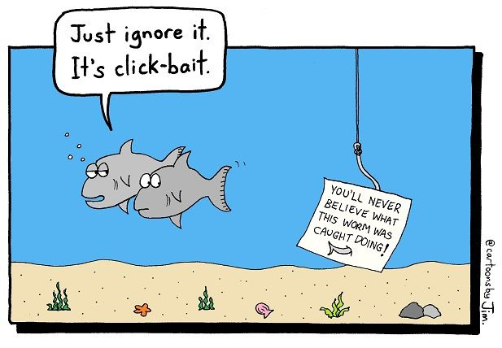
Hook ‘em early
Most people don’t read past the headline, so think carefully about yours
Use an active voice (Harvard launches new initiative vs. New initiative is launched by Harvard)
Ask a question (Will new weapons help Ukraine gain an edge over Russia?)
Be creative, but make sure it’s still descriptive of your story
Don’t use clickbait (you might annoy the reader!)

Slide 8
Congrats! You’ve made it past the headline
Now, try for a compelling lede. Draw the reader in without revealing the full story. Some ideas:
Start with a human connection or anecdote
Ask a question
Describe an intriguing situation
Throw out a shocking statistic
Remember to loop back to your lead at some point in the piece, so the reader doesn’t feel cheated

Slide 9
Body work
Slowly reveal the answers to the questions or ideas you have posed in your lede
Don’t forget the who, what, when, where, why, how
Tip: use subheadings when you want to turn to another idea but don’t have a good way to transition
Try to keep quotes short and pointed
Be consistent – if you’re writing in past tense, stay there
Anticipate how someone might criticize the main points of your story, and offer evidence or arguments against those arguments

Slide 10
Pitfalls to avoid
Avoid dry ledes like: “There was a conference yesterday…”
Try to tell the story from the perspective of an affected individual, not your institution or organization. Client-centered stories are awesome!
Super long quotes can be distracting (and too many quotes as well)
Keep jargon out (How would you explain this to people who aren’t industry insiders?)

Slide 11
General writing tips
Think about your story as a three-act play! (setup, conflict, resolution)
If you get stuck, tell a friend or colleague about your story and ask them what they find most interesting about it. Then lead with that!
If you must use acronyms, spell it out on first mention
Shorter sentences and paragraphs are usually better
Use quotes to add depth to your points, not to restate them
My best advice: read a lot of work by others! I love the Atlantic, New Yorker, and NYTimes Magazine for features

Slide 12
