Slide 1

Information for Incoming LL.M. Students
Office of Clinical and Pro Bono Programs
(OCP)

Slide 2
Welcome incoming LL.M. Class!
Congratulations on your acceptance to the Graduate Program of Harvard Law School (HLS) from all of us at the Office of Clinical and Pro Bono Programs (OCP)! We look forward to working with you this upcoming academic year.
HLS Clinics and Student Practice Organizations (SPOs) provide top-quality legal services to those in need and provide our students with outstanding opportunities to learn and to serve the community through representing real clients on real matters under the supervision of our clinical faculty. Clinics are engaged in a wide range of legal work including working on policy, litigation and transactional matters. Clinics represent a wide range of clients from individuals to non-profits to coalitions of organizations. Some clinics engage in direct legal services in a courtroom setting while others engage in advocacy in other forums. You can learn more about our program in the following slides and by reading the Office of Clinical and Pro Bono Programs website and blog.
OCP oversees the wide-ranging clinical and pro bono opportunities at HLS. Specifically, OCP provides counseling and support to students interested in clinical and pro bono work, coordinates clinical registration and clinical placements, manages the SPOs and the HLS pro bono program and supports the clinical faculty in their work.
If you have questions about the clinical and pro bono programs, please feel free to call or email us. Our contact information is below.
Sheryl Dickey
Assistant Director, Professional Development, Compliance and LL.M Engagement
sdickey@law.harvard.edu
617-495-2216
Maggie Bay
Assistant Director, Curriculum Planning and Registration
mbay@law.harvard.edu
617-495-5284

Slide 3

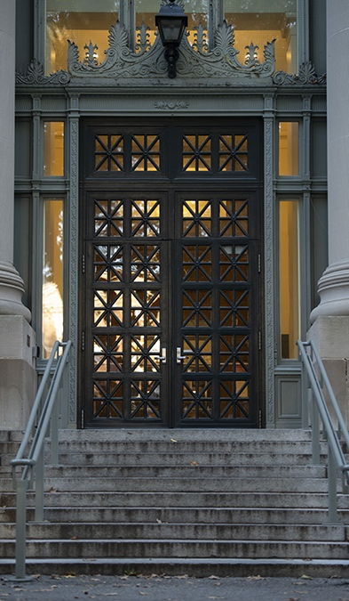
OCP’s Mission
PROVIDE diverse and innovative opportunities for student practice
ADVANCE access to justice through real world cases
INSPIRE students to develop a lifelong commitment to pro bono service
Student Practice Organizations
(SPOs)
Additional Pro Bono Opportunities
HLS
Clinics
+
+

Slide 4

OCP Advising
Our advisors offer direct support on topics including:
Choosing clinics and SPOs
Balancing clinic participation with other courses
Any individual issues that arise in a clinic
Integrating pro bono into a law firm career
Meeting the NY pro bono requirement

Slide 5

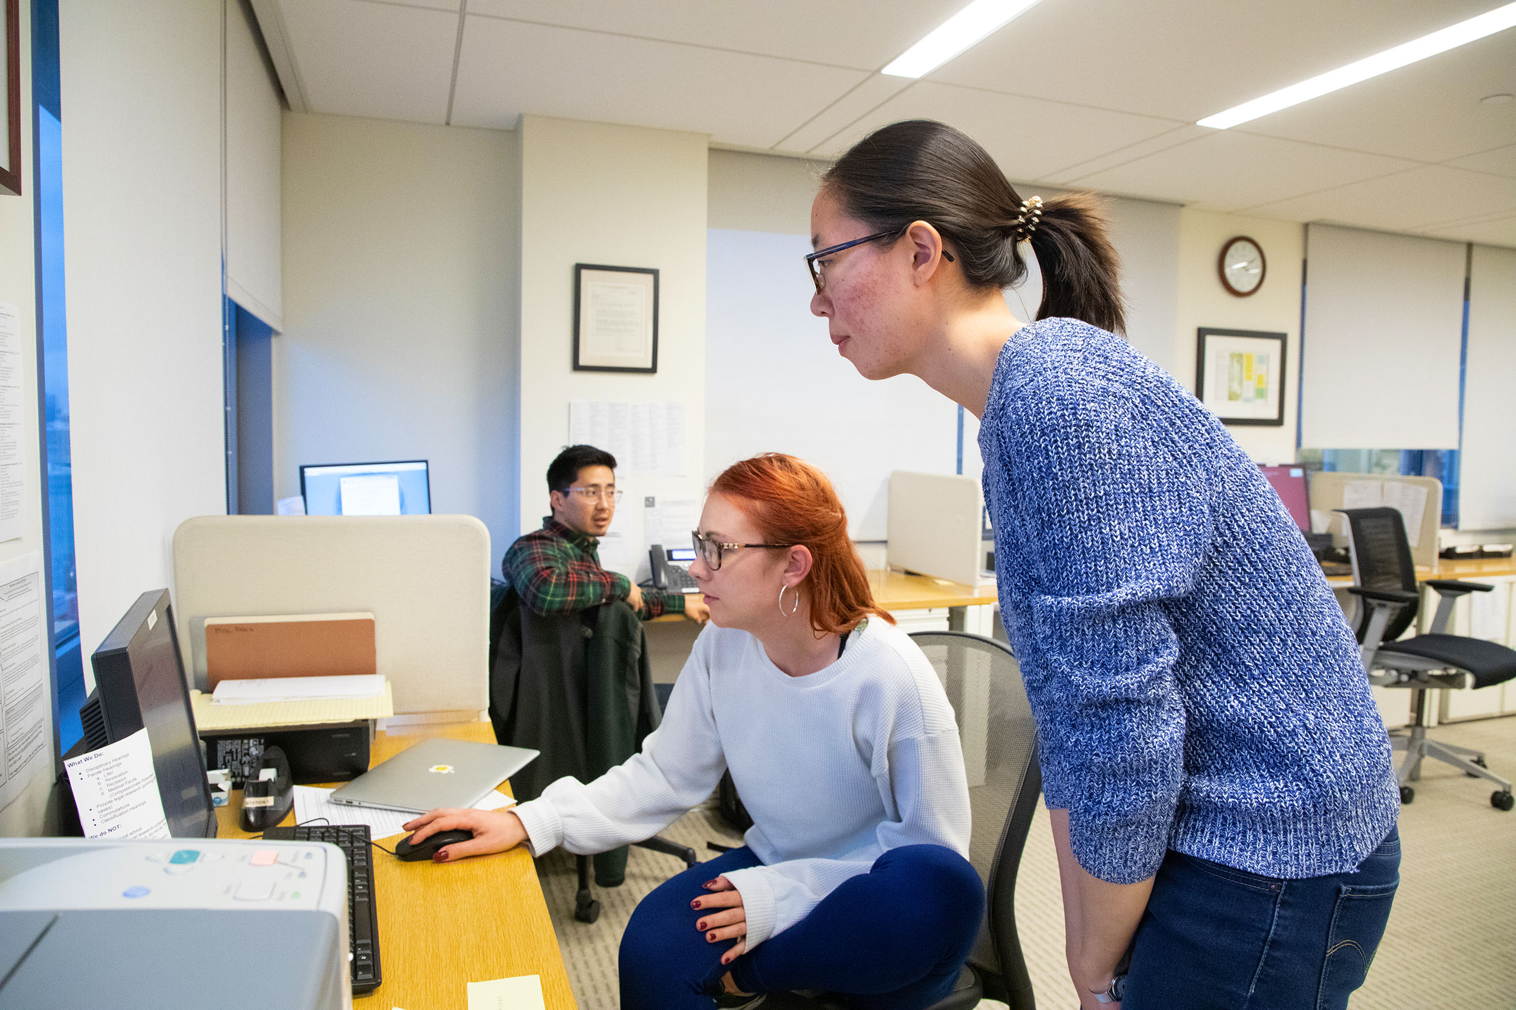
What is a clinic?
Harvard Law School’s approach to clinical legal education has three basic components:
  1. Clinical work providing direct student responsibility for clients and/or cases in a real practice setting;
  2. Supervision, mentorship and feedback by experienced practitioners;
  3. A companion academic course in which the students bring their clinical experience into the classroom while also bringing their classroom training back into their clinical work.
Students receive “clinical credit” for the clinical work and “classroom credit” for the related class component. All credits count towards the credit requirements for the LL.M. degree.

Slide 6
Clinical Skills
Trial Work
Housing Law Clinic
Family Justice Clinic
View the LL.M. Clinical Skills Matrix on our website for more examples!
Client Interviewing
Consumer Protection Clinic
Harvard Immigration and Refugee Clinic
Education Law Clinic
Draft Memoranda and Briefs
Health Law & Policy Clinic
Environmental Law & Policy Clinic

Slide 7
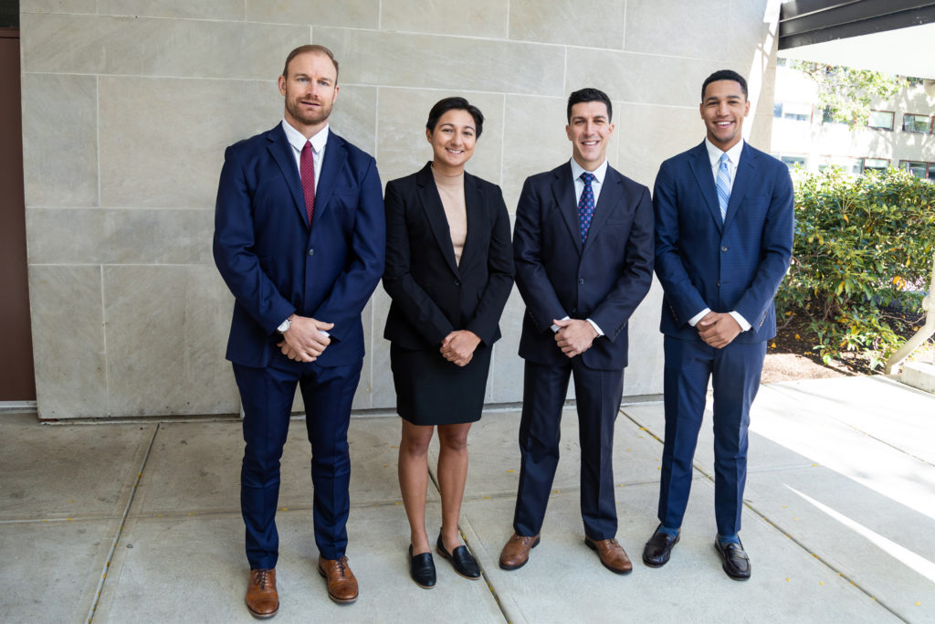
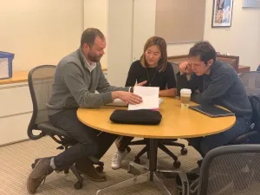

Clinic Stories
Veterans Law and Disability Benefits Clinic
Crimmigration Clinic
Environmental Law and Policy Clinic
Clinic students are representing an LGBTQ veteran who was barred from receiving federal VA benefits as a surviving spouse after his disabled partner’s death, in a potentially precedent-setting case to secure rights for LGBTQ veterans.
The Crimmigration Clinic won a precedent-setting case in the First Circuit with an en banc decision, giving a Salvadoran national another chance at asylum and discrediting the use of gang databases in immigration proceedings.
The clinic submitted comments on a Biden Administration proposal to revise the definition of the “waters of the United States” under the Clean Water Act, recommending restoring and codifying fundamental protections for waters.

Slide 8
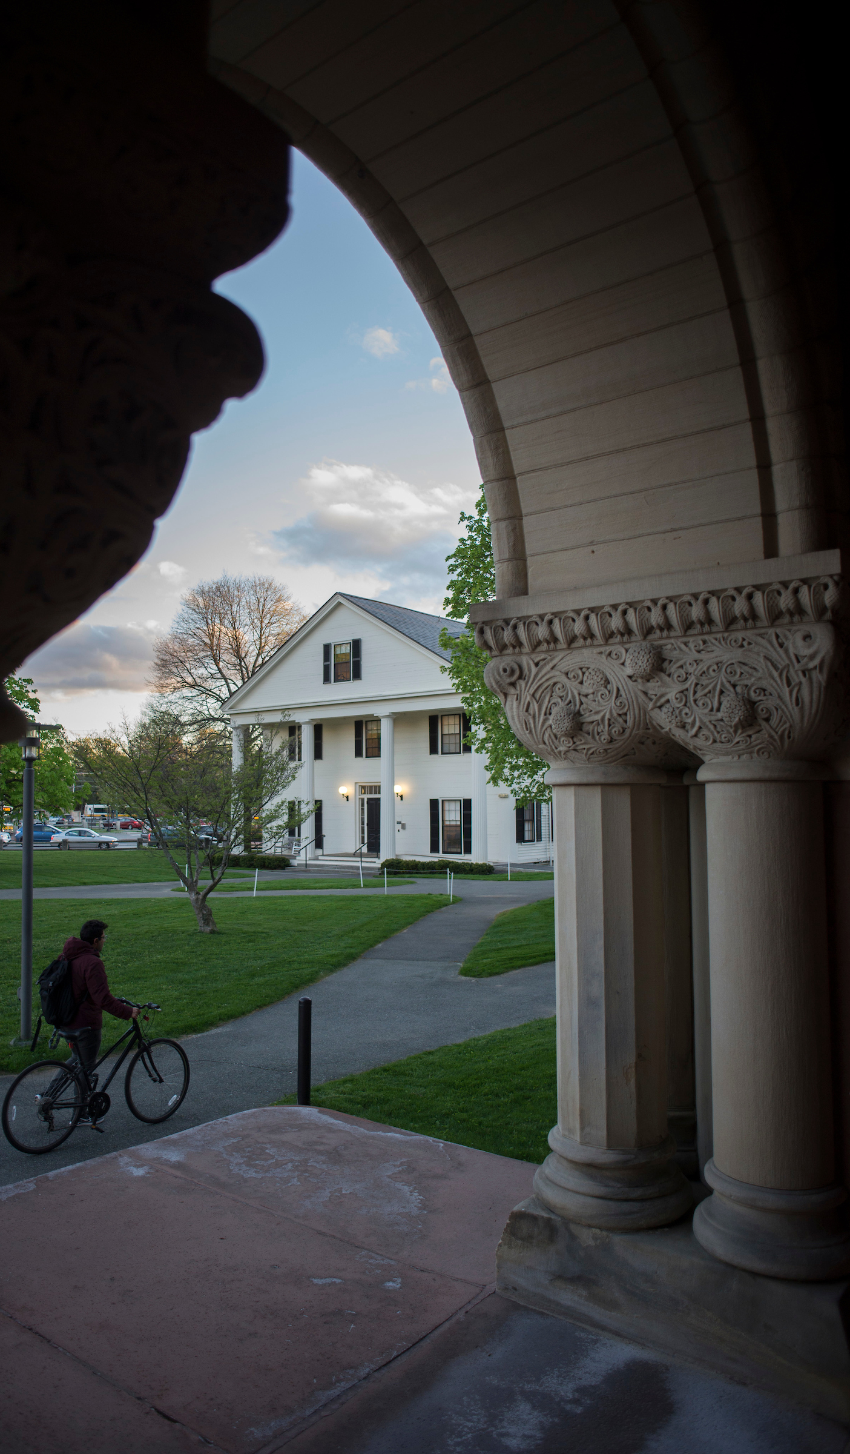
Clinic Participation
Between the clinic component and the clinical classroom component, most clinics require a minimum of 5 credits over a single semester.
LL.M. students in F-1 student status are eligible to enroll in our In-House Clinics:
https://hls.harvard.edu/dept/clinical/clinics/in-house-clinics
Note on our Externship Clinics:
International students on F-1 student visas are required to have Curricular Practical Training (CPT) authorization in order to participate in an externship clinic at HLS; LL.M. students are not eligible for CPT.
If you are not on an F-1 student visa and would like to speak with us about your potential eligibility for externship opportunities, please reach out!

Slide 9
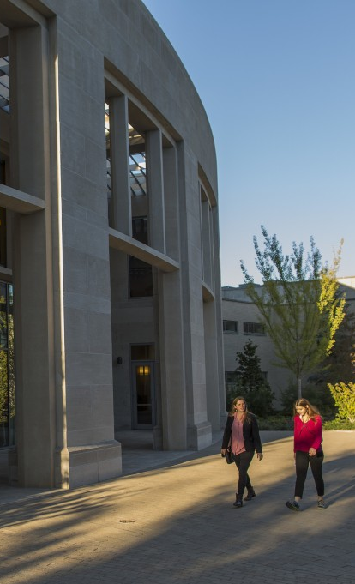
Should you take a clinic?
Does a clinic fit into your overall academic and professional plan?
You should think about how a clinic will factor into your schedule, how it fits into your overall academic goals, and how it will factor into your overall degree requirements. Also, for some students engaged in a job search (especially in the public interest realm) clinics can be a way to demonstrate their commitment to public service; their commitment to a particular subject matter; and/or a way in which they have developed a particular skill set.
How much of a time commitment is a clinic?
Clinics are a serious professional and academic commitment. Most clinic work involves you, the student, representing real clients on actual matters/cases/policies. You must be prepared to dedicate a significant amount of time and effort to a clinic, and you may enroll in no more than one clinic per semester. Once a student enrolls in a particular clinic, they are assigned a clinical supervisor, and the student and their supervisor create a weekly individual clinical work schedule for the student (that fits with the other courses/extra-circulars the student is engaged in).
How many of my credits will I need to commit to a clinic?
If you enroll in a clinic, generally you will be agreeing to engage in 12 (3 credits) to 20 (5 credits) hours per week of clinical work, as well as devoting the time necessary to attend (and do the related coursework) for the mandatory course. If you enroll in a clinic, you will be enrolled in two components – the clinic (generally 3, 4 or 5 credits), and the mandatory related classroom course (generally 2 credits). You can find when the mandatory course(s) is offered and the range of permissible clinical credits for each clinic in the Course Catalog.

Slide 10
Registering for Clinics
Registration for most in-house clinics is through Phase 2 of course preferencing.
We do have a handful of clinics that require an application and are not included in Helios registration (these clinics are listed on their own slide later in this deck).
Clinics have limited seats available each term. When submitting your bids, you will be prioritizing and ranking any clinic bids against other courses that you are interested in for the upcoming year.
When bidding on clinics, you only place a bid for the clinic component (you do not need to use another bid for the required clinical seminar). If you are enrolled in the clinic, you will also be enrolled in the clinical seminar.
For clinics that are offered multiple times each year (e.g. once in the Fall and once in the Spring), you are bidding on each semester of the clinic separately. For example, you could place a bid on the Fall 2023 Cyberlaw Clinic and place another bid on the Spring 2024 Cyberlaw Clinic if you wanted to include both in your list of preferences.
Add/Drop Deadlines
Clinics and clinical seminars have earlier drop deadlines than non-clinical courses, so that the clinics can finalize their caseloads and assign students their supervisors and clients/projects ahead of the start of the term. After the drop deadline has passed, you will not be able to drop a clinic/clinical seminar without Withdrawing (WD).
Fall 2023 – August 18, 2023
Winter 2024 – November 17, 2023
Spring 2024 – December 8, 2023
*Please note that some clinics have even earlier drop deadlines than those listed above

Slide 11
In-House Clinics
Included in Phase 2 of Course Preferencing
Clinics | Semester(s) Offered | Minimum Total Credits
HLS Clinics located on Cambridge Campus
Animal Law & Policy Clinic | Fall or Spring | 5
Crimmigration Clinic | Fall or Spring | 5
Cyberlaw Clinic | Fall or Spring | 5
Education Law Clinic: Legislative & Administrative Lawyering | Spring | 5
Emmett Environmental Law & Policy Clinic | Fall or Spring | 5
Food Law & Policy Clinic | Fall or Spring | 5
Harvard Dispute Systems Design Clinic | Fall or Spring | 5
Harvard Immigration and Refugee Clinic | Fall or Spring | 5
Health Law & Policy Clinic | Fall or Spring | 5
Human Rights Entrepreneurs and Incubator Clinic | Fall or Spring | 5
International Human Rights Clinic | Fall or Spring | 5
Mediation Clinic | Fall | 2
Transactional Law Clinics | Fall or Spring | 6
HLS Clinics located in Jamaica Plain (Legal Services Center)
Consumer Protection Clinic (LSC) | Fall or Spring | 5
Family Justice Clinic (LSC) | Fall or Spring | 5
Housing Law Clinic (LSC) | Fall or Spring | 5
LGBTQ+ Advocacy Clinic (LSC) | Fall or Spring | 5
Tax Litigation Clinic (LSC) | Fall or Spring | 5
Veterans Law & Disability Benefits Clinic (LSC) | Fall or Spring | 4

Slide 12
By Application Clinics and Timelines
Please review the Course Catalog descriptions for each clinic to confirm the application process. Clinics will review all applications once the deadline has passed. If accepted, OCP will work with individual students to register for the clinic and clinical seminar components.
July 15, 2023
Election Law Clinic (Fall or Spring)
Religious Freedom Clinic (Fall or Spring)
October 13, 2023
Institute to End Mass Incarceration Clinic (Spring)
Rolling Basis Up Until October 15, 2023
Making Rights Real: The Ghana Project Clinic (Winter-Spring or Spring)
October 31, 2023
Environmental Law & Policy Clinic - Winter 2024 Only
(the Fall 2023 and Spring 2024 offerings of the Environmental Law & Policy Clinic are included in Phase 2 registration)

Slide 13
Frequently Asked Questions
Do you need to have prior academic or professional experience in a particular issue area to participate in a clinic?
No. Applicants need not have prior legal or academic experience in the issue areas that a clinic works in. Students will receive the necessary training on the relevant substantive issues and skills required to work in a clinic. Students with a new or exploratory interest in a field are welcome to apply.
What are clinical credits? Can I choose the number of credits I sign up for?
The number of clinical credits a student enrolls in translates directly to the number of hours per week they will be engaging in clinical work. Clinics set a range of allowable credits, and then students choose an initial number of credits to sign up for. Students can then increase or decrease that number
once the semester is under way, within established credit minimums and maximums for the LL.M. degree. For more information about clinical credit requirements, please visit our website: http://hls.harvard.edu/dept/clinical/clinical-credits
If I register in a clinic, do I have to participate or can I drop it?
You can drop a clinic without penalty any time before the clinic’s drop deadline. Once the drop deadline has passed, you can no longer drop the clinic.
I am on the waitlist for a clinic. What are the chances that I will get a waitlist offer and be able to enroll?
Clinic waitlists tend to move a lot! You will see your waitlist position change in Helios throughout the add/drop period. Waitlists for spring clinics move more than waitlists for fall clinics. Please contact our office if you want to talk more about the waitlist process and your chances of being able to enroll!
How can I learn more about the clinic experience from the student perspective?
Students can review evaluations from prior students by logging into Helios and searching by clinic in the Public Service Org Search. You can also learn more about the clinics by watching the information sessions and video Q&A’s on our website.
Do clinics meet the requirements for courses that count towards eligibility to sit for the New York Bar Exam?
If you are a student hoping to establish eligibility to sit for the New York Bar Exam through a qualifying LL.M. degree, please note that under Rule 520.6(b)(3)(vii)(a), you will likely be able to count your credit hours earned in clinical courses and other experiential courses towards the required credits. At HLS, this includes both in-house clinics and externships. Please consult the Graduate Program if you have additional questions related to eligibility.

Slide 14

Independent Clinical Program
Work with OCP to design a custom placement outside of the U.S. during the winter term to meet your individualized learning goals.
How it works:
Identify an international placement organization
Secure supervising attorney and faculty sponsor
Submit an application to OCP
Winter – 2 clinical credits
Winter 2024 Application Deadline:
October 27, 2023
If interested in this opportunity, please contact Sheryl Dickey at sdickey@law.harvard.edu

Slide 15
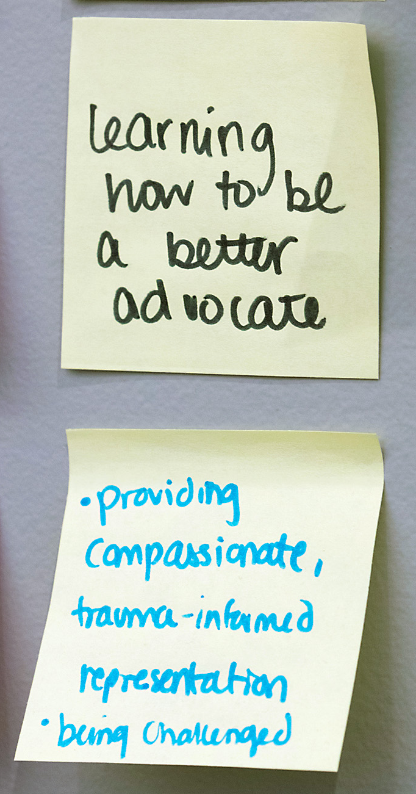
Student Practice Organizations (SPOs)
In addition to the clinics, students can engage in pro bono (not for academic credit work). SPOs are student-run volunteer opportunities for students to gain practical legal experience through representing clients. Each SPO has at least one supervising attorney, given there is legal practice involved, but the leadership and management of these organizations are student organized.
Learn more about how to get involved at the SPO Fair in mid-September.
Harvard Defenders
Harvard Law Entrepreneurship Project
Harvard Mediation Program
Harvard Law Negotiators
Harvard Prison Legal Assistance Project
HLS Advocates for Human Rights
HLS Immigration Project
Mississippi Delta Project
Project No One Leaves
Recording Artists Project
Tenant Advocacy Project

Slide 16

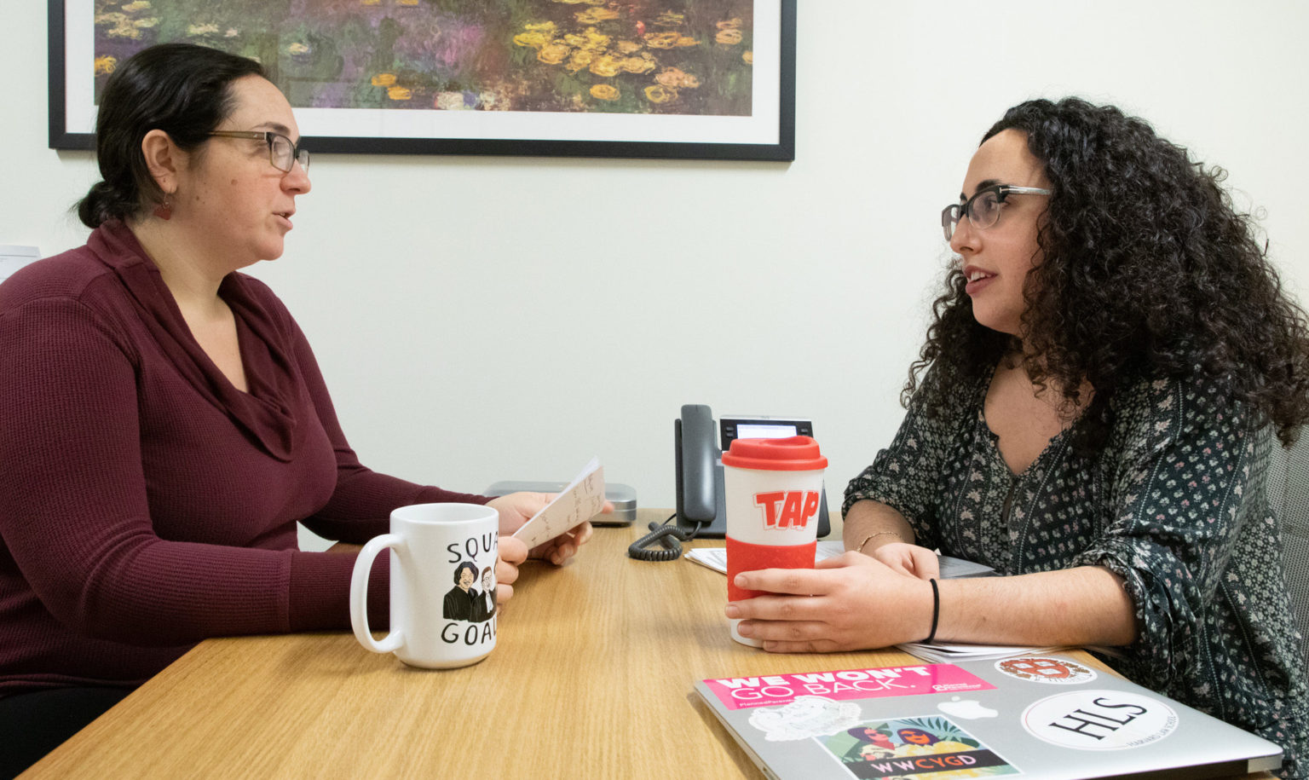
SPO Stories
Prison Legal Assistance Project (PLAP) students represented incarcerated individuals after a 2020 uprising that resulted in false disciplinary reports and physical abuse from corrections officers. Documents and testimony obtained by PLAP helped further a recent federal class action lawsuit brought by Prisoners’ Legal Services.
In Fall 2021, the Harvard Immigration Project submitted comments on a proposed federal rule regarding asylum procedures and credible fear screenings. HIP called for the rule to be eliminated or substantially changed, due to its undermining of asylum seekers’ due process rights.

Slide 17
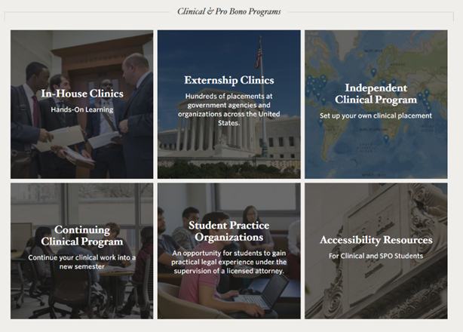
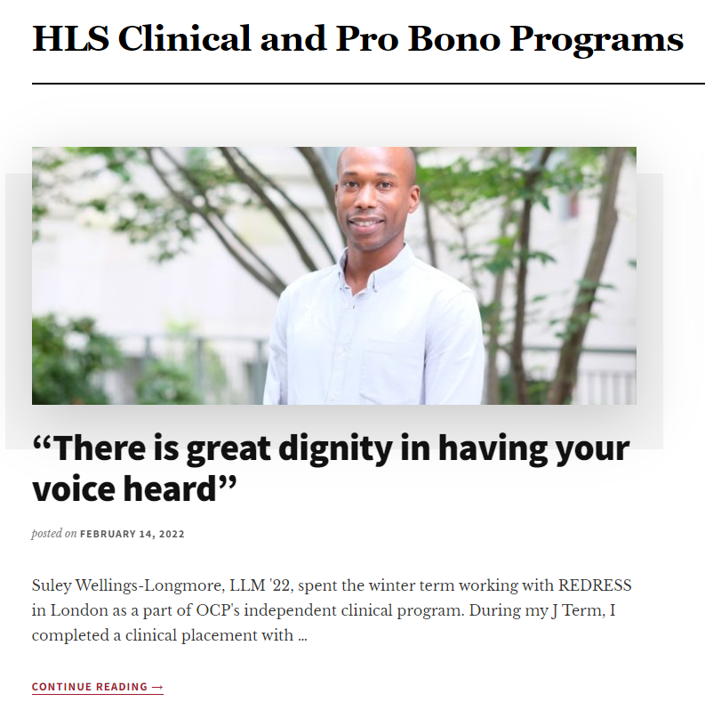
Communications from OCP
Contact:
Sheryl Dickey
Assistant Director, Professional Development, Compliance and LL.M Engagement
sdickey@law.harvard.edu
617-495-2216
Maggie Bay
Assistant Director, Curriculum Planning and Registration
mbay@law.harvard.edu
617-495-5284
Website
hls.harvard.edu/dept/clinical
Blog
clinics.law.harvard.edu

